Slide 1


Hajoca Corporation
Timothee Andre & Larry Baucum

Slide 2

What is Hajoca?
Hajoca is a wholesaler providing plumbing, HVAC, pool supplies, and industrial PVF to homeowners and contractors since 1858.
Hajoca is a privately owned corporation that serves the United States through its 417 locations.
Hajoca is headquartered in Lafayette Hill, PA, and has 1,852 employees.
Hajoca provides over 100,000 products from over 500 suppliers to everything from entrepreneurs to industrial companies.

Slide 3

Logical and Security Layout
The network uses a hub and spoke for the WAN and a star for the LAN.
The NIST security framework will be used to protect Hajoca assets by detecting threats and vulnerabilities, responding to incidents, and recovering from incidents.
This will include Policy, employee training, access control, SOAR and SIEM products, and redundancy.
The different groups that Hajoca has are executives, sales, operations, marketing, finance, human resources, information technology, customer service, product management, quality assurance, and legal.
Hajoca has many assets that require protection including customer and employee information, supplier and subsidiary business information, sales history, networking equipment, logical network, products, product support tools, and physical locations.

Slide 4
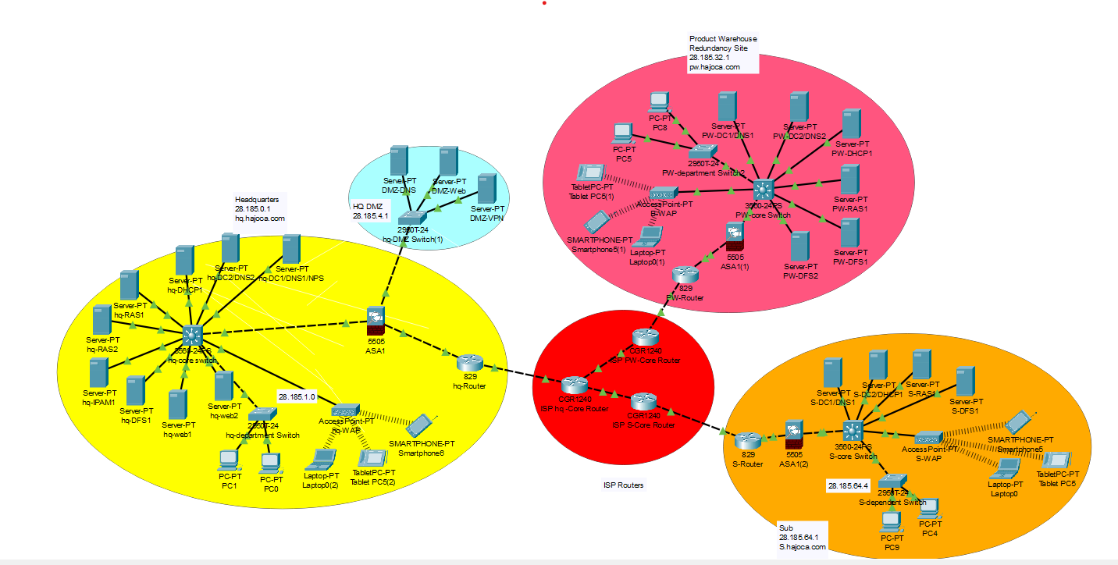
Hajoca Network Layout

Slide 5
Connection and Access managment
Account management
Authentication
Access control
Connection Security

Slide 6
Plans For Physical Security
Access control: access cards, locks, and other systems that restrict access to servers, inventory, and sensitive information
Fences, surveillance cameras, IDS, and IPS that monitor threats
Security training for employees
Penetration testing and vulnerability scanning to find vulnerabilities
Having a business continuity plan and disaster recovery plan
Security policies such as account management policies and asset management policies

Slide 7
Identify and Protect
Protect
Identities and credentials are managed
Physical access to assets are managed and protected
Access permissions and least privilege
Identify
Risk assessment
Access Control

Slide 8
Threat Matrix
 | Negligible | 2. Minor | 3. Moderate | 4. Major | 5. Catastophic
5 | Team member out sick | Employee miscommunication | Network Congestion | Competitor opens
4 | Temporary power outage | Data entry errors | Someone tailgates into warehouse | Client info stolen in breach | Server room overheating
3 | Minor software bugs and glitches | Equipment malfunctions | Successful phishing attack, limited breach | Insider threat from team member | Lawsuit against company
2 |  | Losses due to theft | Accidental file deleting | Loss of staff | Major natural disaster
1 |  |  | DNS poisoning attack | Extended power outage | Internet loss for entire company

Slide 9
Detect
Security Training
Vulnerability scanning
Pen testing
Detection software
Logging
Roles and responsibilities will be defined
Ensuring detection activities meet compliance
Processes are tested
Processes are improved

Slide 10
Respond and Recover
Recover:
Recovery plans that include lessons learned
Continuously updated recovery strategies
Respond:
Incident response plan

